Slide 1
ADOPT-A-STREET
City of Lincoln
Safety Guidelines

Slide 2
The safety of Adopt-A-Street participants is always the utmost consideration of the City of Lincoln. The Adopt A-Street program is designed so common-sense safety will prevail. Participants bear individual responsibility for personal safety and appropriate behavior when working within the limits of a City maintained street.
City of Lincoln safety requirements must be provided to every participant, and must be reviewed before entering the right-of-way. Group leaders are responsible for conducting safety briefings for all participants prior to each cleanup event.
Allow no more than a total of 12 participants during any cleaning event (unless prior authorization is given). Minors under the age of thirteen (13) shall not be allowed. An adult supervisor shall be provided for every five (5) minors.

Slide 3
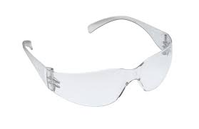
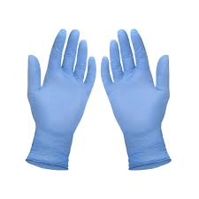
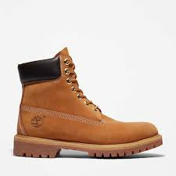
Safety Equipment
High visibility safety vest is required to be worn at all times while working roadside. The safety vest must worn in a way to ensure the worker stands out and is set apart from the background
Protective eye wear should be worn at all times while working roadside.
Gloves should be worn while picking up trash and other debris
Closed toe shoes or boots and long pants should be worn while working roadside

Slide 4
Working Roadside
While on the roadside, remember: Safety First!
Use caution when crossing roads. Use crosswalks and signals where available.
Do not enter lanes to pick up trash and/or debris.
Face oncoming traffic as you work, and keep an eye on all moving vehicles. Be prepared to move quickly, if necessary. Work behind the berm or curb, or six feet from the edge of pavement where there are no berms or curbs.
Provide a person whose only job is to observe traffic, and warn of any vehicles being driven erratically. That person should carry some type of warning device (horn) to alert other participants to erratically driven vehicles.
Not distracting or interfering with motorists.
Do not run, throw objects, engage in horseplay, or any other activity that may distract drivers.
Do not work before dawn, and discontinue work at dusk.
Any vehicles used by your group must be legally parked off the traveled way, in a manner not interfering with the free flow of vehicular, pedestrian or equestrian traffic. Do not park in areas with dry vegetation, which can be ignited by hot exhaust systems. Do not use emergency flashers. Do not park under bridges

Slide 5
hazards
Do not touch or attempt to remove any materials that you suspect may be toxic or hazardous. Items to avoid may include but not limited to: powders, chemicals, smelly substances, suspicious packages, chemical drums or containers, weapons, syringes or hypodermic needles, dead animals, or broken glass. Notify DPW or Lincoln Police Department non-emergency phone number of the location of weapons or suspected toxic substances immediately.
Do not attempt to work when fog or other conditions reduce visibility for drivers. Do not attempt to work when the street is icy or wet.
Do not try to compact filled trash bags. Injuries from broken or jagged objects may occur.
Be alert for places where snakes may be located. Also, be alert for stinging insects, poisonous plants (poison oak, etc.), broken glass, and hypodermic needles.
Avoid overexertion. Drink plenty of water, especially on warm, humid days.
Do not consume alcoholic beverages or drugs before entering, or while on the roadside.

